Slide 1



Project Presentation On
“DESIGN AND FABRICATION OF REACTOR FOR THE EXTRACTION OF FUEL FROM WASTE PLASTIC BY USING PYROLYSIS PROCESS”
Department of Mechanical Engineering
NCET, Bangalore
Presented by:- Under the Guidance of:-
Mr. Yashas G M(1NC18ME047) Mr. Ravi Y V
Mr. Sumanth P(1NC18ME039) Assistant Professor
Mr. Rakesh K S(1NC19ME412) Department of ME, NCET
Mr. Vishnu H S(1NC18ME046)

Slide 2
CONTENTS
Abstract
Introduction
Literate survey
Objectives
Result
Conclusion
Work done
Scope for future work
References

Slide 3
ABSTACT
The present rate of economic growth is unsustainable without saving of fossil energy like crude oil, natural gas, or coal. There are many alternatives to fossil energy such as biomass, hydropower, and wind energy. Also, suitable waste management strategy is another important aspect.
Development and modernization have brought about a huge increase in the production of all kinds of commodities, which indirectly generate waste. Plastics have been one of the materials because of their wide range of applications due to versatility and relatively low cost.
Our Project deals with the extraction of oil/diesel from the waste plastics termed as plastic pyrolyzed oil which can be marketed at much cheaper rates compared to that present in the market. As we know that both Plastics and Petroleum derived fuels are Hydrocarbons that contain the elements of Carbon & Hydrogen.
Pyrolysis process becomes an option of waste-to-energy technology to deliver bio-fuel to replace fossil fuel. The advantage of the pyrolysis process is its ability to handle unsort and dirty plastic. The pre-treatment of the material is easy. Plastic is needed to be sorted and dried. Pyrolysis is also no toxic or non-environmental harmful emission unlike incineration.

Slide 4
INTRODUCTION
Plastic products have become integral part of our lives and play an irreplaceable role in day to day activities. It is impossible to imagine life without plastic and in other hand, production cause by plastic are become burning issues so from last few years, researchers, professors, environmentalist are very much interested in developing the technique for the management of solid waste.
The consumption of plastic material is vast and has been growing steadily in the view of advantages derived from their versatility, relatively low cost, light weight, and durability.
Most plastics are consumed in many applications such as packaging, building, electricity, electronics, agriculture, health cares and in different fields.

Slide 5

BENEFITS FOR USING PYROLYSIS PROCESS:
Reduction in volume of waste (<50–90%).
All the three types of fuel like solid, liquid and gas can be produced.
The fuel obtained can be stored and transported easily.
The problems related with environment are greatly reduced.
Energy can be derived from renewable sources like municipal solid waste or sewage sludge.
It involves low capital cost.

Slide 6
INTRODUCTION
Due to the fossil fuel crisis in past decade, mankind has to focus on developing the alternate energy sources such as biomass, hydropower, geothermal energy, wind energy, solar energy, and nuclear energy. The developing of alternative-fuel technologies is investigated to deliver the replacement of fossil fuel.
The waste to energy technology is investigated to process the potential materials in waste which are plastic, biomass and rubber tire to be oil. Pyrolysis process becomes an option of waste-to-energy technology to deliver bio-fuel to replace fossil fuel.
Thermosetting plastics can be re-melted into liquid by supplying enough heat and hardened on cooling so that they can be made into new plastics products. E.g.: polyethylene, polystyrene and polyvinyl chloride and many others.
Thermosetting plastics are synthetic materials that strengthen during being heated but cannot be remolded or reheated after their initial heat forming. E.g.: phenol formaldehyde, urea formaldehyde, vulcanized rubber and fiber glasses and so on

Slide 7
INTRODUCTION
High Impact Polystyrene (HIPS) – used in fridge liners, food packaging, vending cups.
Acrylonitrile butadiene styrene (ABS) – used in electronic equipment cases (e.g., computer monitors, printers, keyboards), drainage pipe.
Polyester (PES) – used in fibers , textiles.
Polyamides (PA) (Nylons) - used in fibers , toothbrush bristles, fishing line, under-the hood car engine mouldings.
Polyurethanes (PU) - used in cushioning foams, thermal insulation foams, surface coatings, printing rollers.
Polycarbonates (PC) - used in CDs, eyeglasses, riot shields, security windows, traffic lights, lenses.
Polycarbonate/Acrylonitrile Butadiene Styrene (PC/ABS) - A blend of PC and ABS that creates a stronger plastic. Used in car interior and exterior parts and mobile phone bodies.

Slide 8
INTRODUCTION
Melt-temperature ranges and decomposition in the molten state of some thermoplastics

Slide 9
LITERATURE SURVEY
M. F. Ali reported that the high yields of liquid fuels in the boiling range 100°C–480°C and gases were obtained along with a small amount of heavy oils and insoluble material such as gums and coke.
Sumit Bhat and Rohit Singh Lather Utilization of waste effectively and efficiently is one the major concern in today’s world. The depleting natural resources (like fossil fuels) add further to this concern. The need of the hour is to adopt some measures which can help to manage wastes and at the same time to create some alternate fuels out of the waste only to conserve the precious fossil fuels.
Pawar Harshal R. and Lawankar Shailendra M Environmental concern and availability of petroleum fuels have caused interests in the search for alternate fuels for internal combustion engines. Conversion of waste to energy is one of the recent trends in minimizing not only the waste disposal but also could be used as an alternate fuel for internal combustion engines.

Slide 10
OBJECTIVES
The main objectives of this project are:
The aim of this research is to study fuel oil production from plastic wastes by sequential pyrolysis and catalytic reforming processes.
Studying different types of plastics and to find out environmental effects by plastic
To develop and fabricate the machine to convert plastic material into crude oil.
To reduce the dependency on gulf countries for fossil fuels, thereby contributing to the Economic growth of the country.

Slide 11
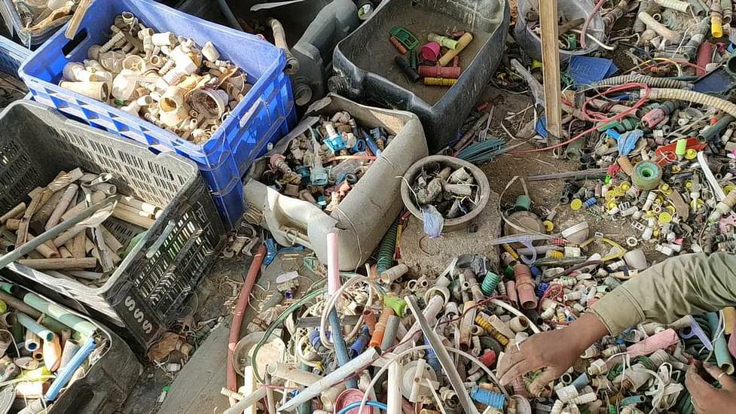
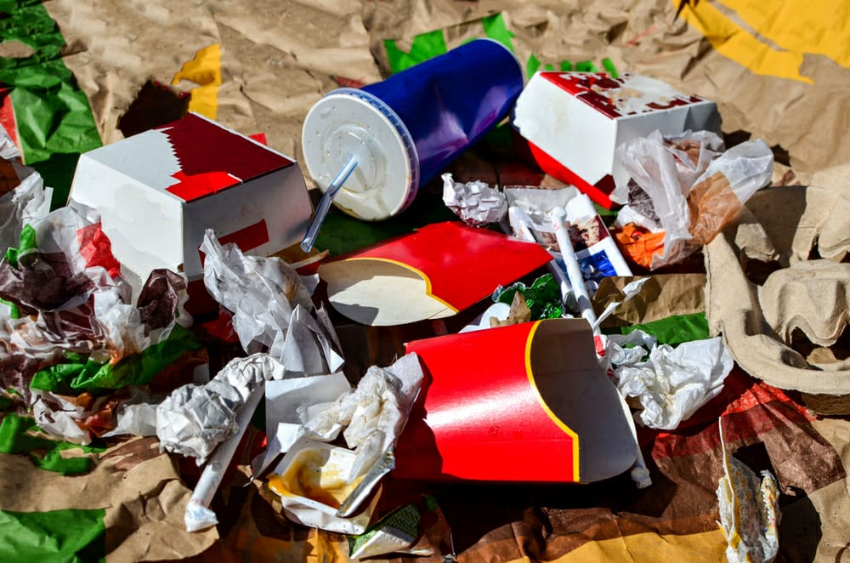
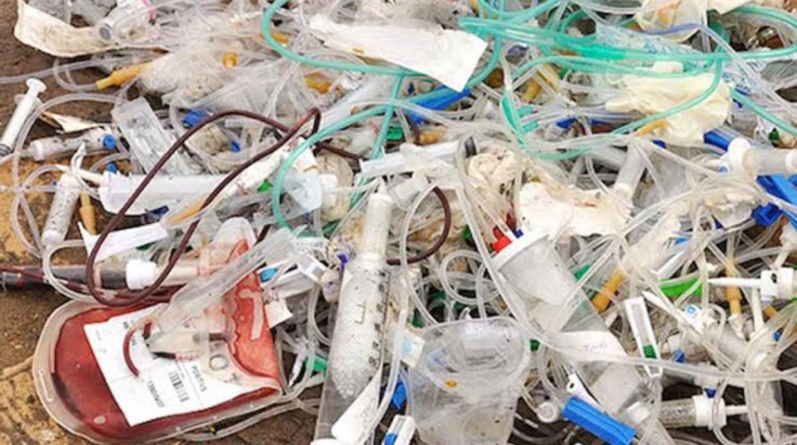
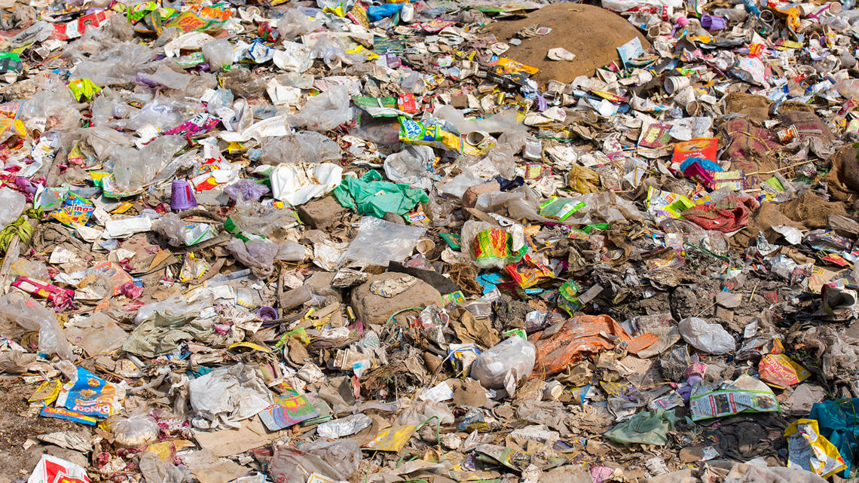
COLLECTION OF WASTE PLASTIC FROM MECHANIC SHOP,FAST FOODS,HOSPITALS,HOUSE HOLD WASTE.

Slide 12
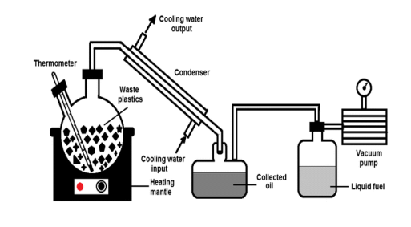
METHODOLOGY
A. Material Required :
Waste plastic which is high-density polyethylene, PET, PS, PP because pyrolysis cannot be performed on all types of plastic. The plastic waste found at retailers’ shop, single-time use plastic bottles and all sort of plastic waste which can be used are being collected as the material for the experiment.
B. Experimental Setup :
The experimental setup is shown in fig. A container, a pyrolizer, test tubes/pipes, collector in which the fuel will collected.

Slide 13
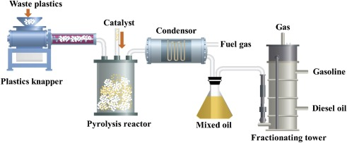
SUBJECTING THE WASTE PLASTIC FOR PYROLYSIS
The collection of waste plastic is quite an easy task as compared to other wastes, the plastic wastes are abundant and can be obtained in large quantities from the households, roadsides, hospitals, hotels etc.
The pyrolysis is a simple process in which the organic matter is subjected to higher temperature about 150ºC to 200ºC in order to promote thermal cracking of the organic matter so as to obtain the end products in the form of – liquid, char and gas in absence of oxygen.

Slide 14
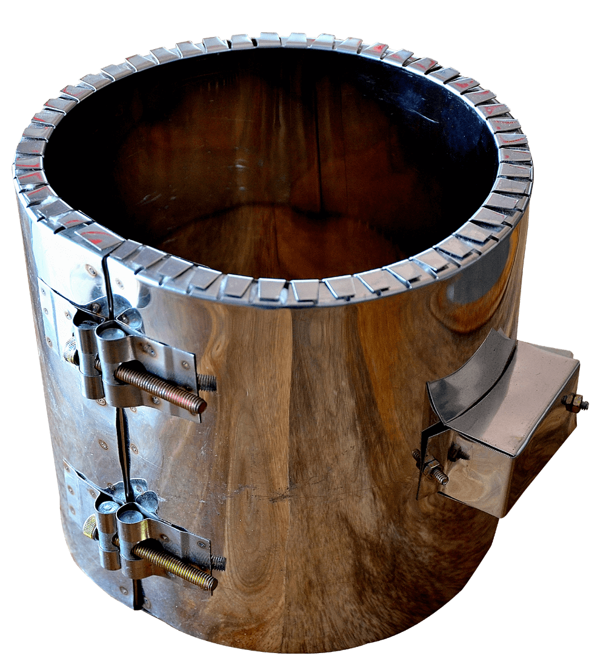
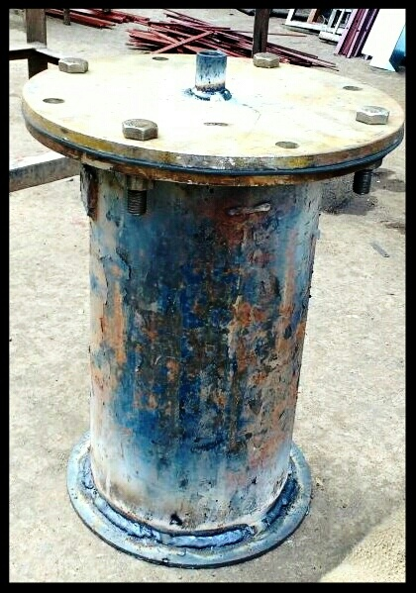
DESIGN DETAILS OF THE INSTRUMENT
Material = Mild Steel
Top diameter = 25 cm
Bottom diameter = 25 cm
Depth = 40 cm
Volume = 19634 cm
Diameter of outlet = 2.54 cm
Weight of mould = 14 kg
Digital thermometer (up to 2000°C)
Electric Band heater
TECHNICAL FEATURES
Diameter – 160mm
Height – 180 mm
Power / Wattage – 2 Kw
Voltage – 230 V
Maximum temperature - 420℃
Sheath material – Stainless steel
Insulation material – Ceramic fibre blanket
CERAMIC BAND HEATER
FABRICATED REACTOR

Slide 15
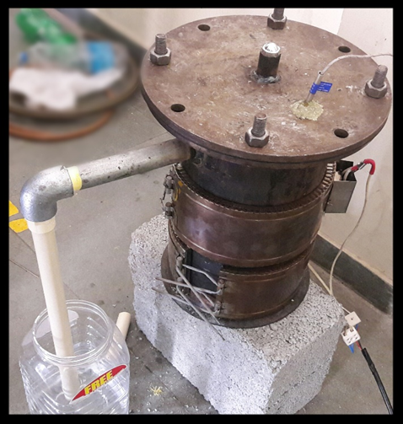
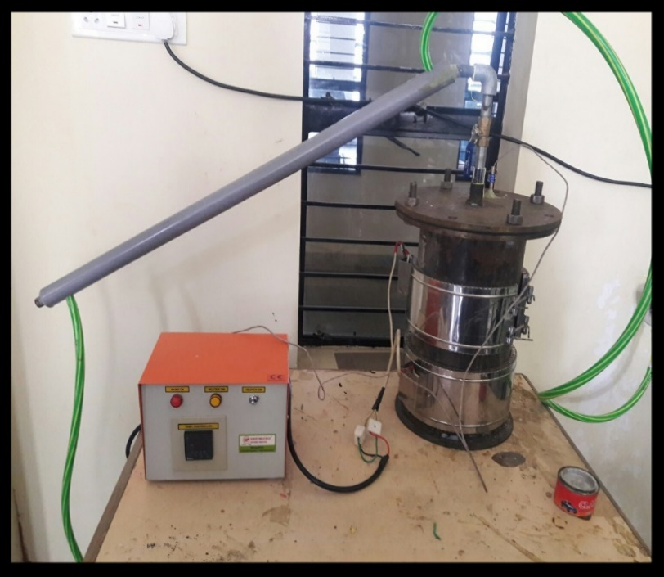
EXTRATION PROCESS IN SPECIALY DESIGNED MOULD (PYROLYZER)
The below picture shows the mold prepared to serve as a pyrolyzer device.
Redesigned reactor for pyrolysis process
Reactor for pyrolysis process

Slide 16
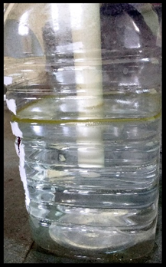
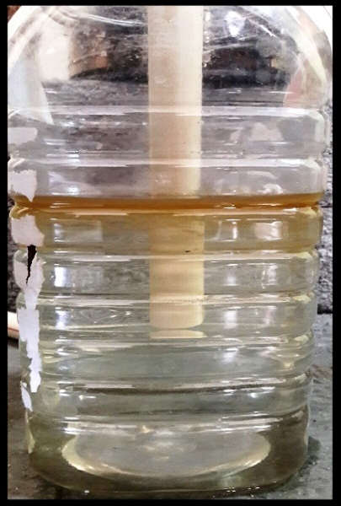
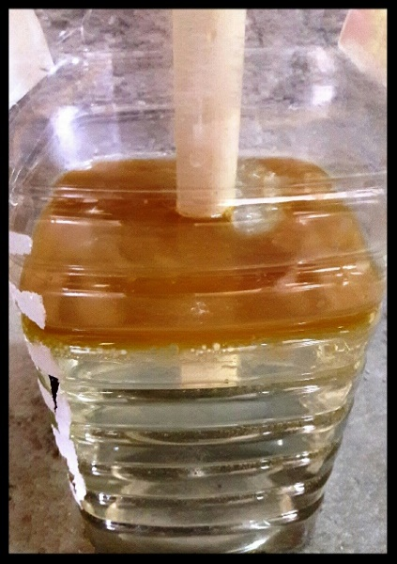
CONDENSATION OF GAS TO OBTAIN CRUDE OIL
After heating the waste plastic at a temperature of about 300⁰C to 500⁰C in the pyrolyzer the gas is allowed to escape through the outlet dipped into the water containing jar so as to condense the fumes to obtain the RAW FUEL floating over the surface as shown in picture below , which is further taken out through the outlet provide to the water containing jar.
Initial condition before Condensation
A layer of oil formed at the top surface after Condensation of the gases.

Slide 17
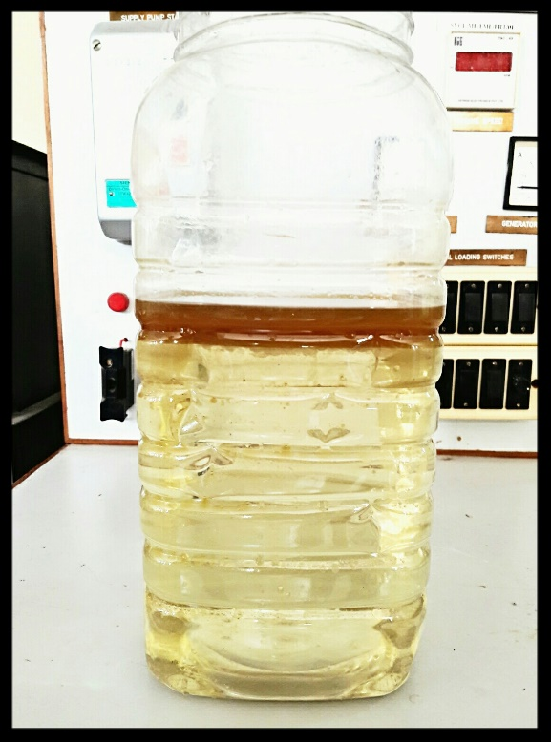
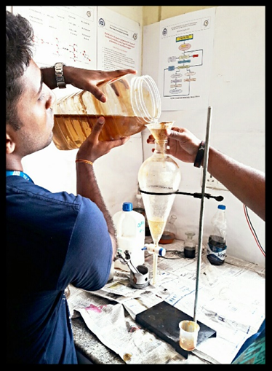
Crude oil collected from about 750gm of Plastic.
Subjecting crude oil and water mixture to sedimentation process.

Slide 18
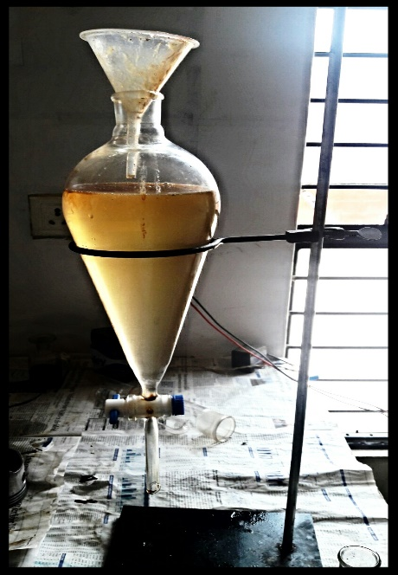
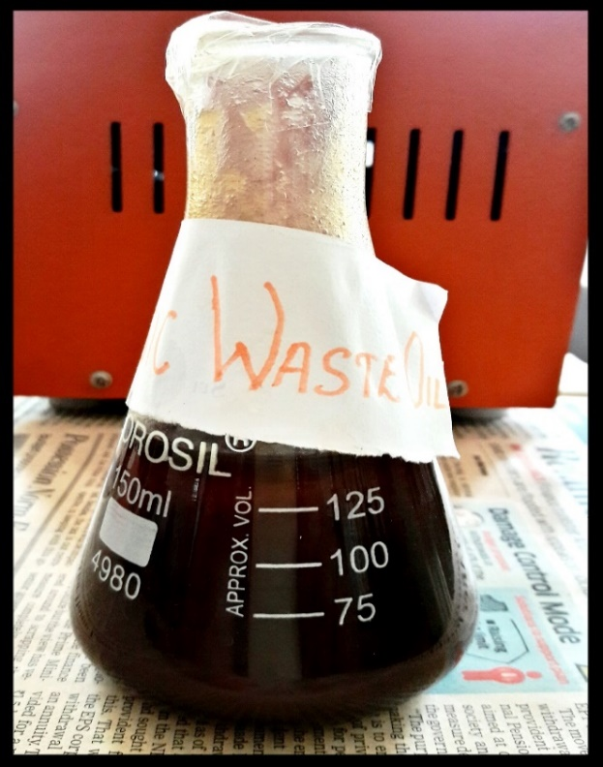
Sedimentation
Final Raw fuel collected after separated it from water.

Slide 19
PHYSICAL PROPERTIES OF WASTE PLASTIC OIL
Properties | Waste plastic oil
Density at 30⁰C (in g/cm³) | 0.874
Kinematic Viscosity (Centistokes) | 4.31
Flash point (in ⁰C) | 107
Fire Point (in ⁰C) | 118
Overall results for pyrolytic oil blends

Slide 20
RESULTS
1. Through the experimentation it concluded that about 300 to 450ml of diesel fuel could be obtained by burning 750gm of plastic. Burning 750gm of plastic in an open environment produces 3Kg of CO₂, whereas by converting it into fuel and burning it reduces 80% of CO₂ emissions, which results in to be quite environmentally friendly.
2. Lesser emission of unburnt HYDROCARBONS in waste plastic pyrolysis oil compared to that of diesel.
3. The diesel or oil thus obtained has a higher efficiency with around 30 to 40% low production cost compared to that available in the market.

Slide 21
CONCLUSION
1. It is very difficult to find out alternative of plastic. Even plastic’s demand is increasing every day as well as their waste. This project analysis has observed the use of waste plastics, a factory planning and its feasibility in Metropolitan City. It is easily assumed that, when the use of waste plastic will increase then the solid waste management will search more ways to find out to collect them.
2. The use of plastic pyrolysis oil in diesel engine in the aspect of technical and economical is compared and found that oil is able to replace the diesel oil. Though the plastic pyrolysis oil offers lower engine performance, the plastic waste amount is enormous and it needed to be process to reduce the environmental problems. Moreover, the engine can be modify follow the combustion condition of plastic pyrolysis oil. The waste plastic used in the process must be PE or PP or LDPE in order to protect the contamination of chlorine in the oil.

Slide 22
WORK DONE
Selection of waste plastic
2. Listing of Reactor Properties
3. Methodology finalization
4. Equipment center Identification
Pyrolysis Process.
Condensation of gas to obtain crude oil.
Conduction of Testing’s .

Slide 23
SCOPE FOR FUTURE WORK
As there is a high demand of crude oil and due to its sky reaching prices, we could take up this project to setup large or small scale industries and produce the fuel locally at much cheaper rates directly benefiting the National economy and also a step towards SWAACH BHARAT by recycling the waste plastic.
The application of this project could help in reducing the dependency on the gulf countries and promote a step towards innovation.

Slide 24
REFERENCES
[1] M. F. Ali, S. Ahmed, M. S. Qureshi, Catalytic coprocessing of coal and petroleum residues with waste plastics to produce transportation fuels Fuel Processing Technology 92 (2021) 1109–1120.
[2]SumitBhat and Rohit Singh Lather, “Production of Oil from Waste Plastics and Polythene using Pyrolysis and its Utilization in Compression Ignition (C.I.) Engine”, Vol 9(48), December 2020.
[3]PawarHarshal R. and LawankarShailendra M, “Waste plastic Pyrolysis Oil Alternative Fuel for CI Engine”, Vol. 2(2), 26-30, February 2013.
[4]SenthilkumarTamilkolundu and ChandrasekarMurugesan, “The Evaluation of blend of Waste Plastic Oil Diesel fuel for use as alternate fuel for transportation”, April 28-29, 2012.
[5]Sunbong Lee, Koji Yoshida &Kunio Yoshikawa, “Application of Waste Plastic Pyrolysis Oil in a Direct Injection Diesel Engine: For a Small Scale Non-Grid Electrification”, Vol. 5, No. 1; 2015.

Slide 25
REFERENCES
[6]Mitusuhara, waste plastics to produce transportation fuels Fuel Processing Technology 72(2019).
[7]Anup T J, “Waste Plastic Pyrolysis Oil as Alternative for SI and CI Engines” International Journal of Innovative Research in Science, Engineering and Technology (An ISO 3297: 2007 Certified Organization) Vol. 3, Issue 7, July 2014.
[8]G. Elordi, M. Olazar, G. Lopez, “Catalytic pyrolysis of HDPE in continuous mode over zeolite catalysts in a conical spouted bed reactor,” Journal of Analytical and Applied Pyrolysis, vol. 85, no. 1-2, pp. 345–351, 2009.
[9] D. S. Scott, S. R. Czernik, J. Piskorz, and D. S. A. G. Radlein, “Fast pyrolysis of plastic wastes,” Energy & Fuels, vol. 4, no. 4, pp. 407–411, 1990.
[10] Mitusuhara, waste plastics to produce transportation fuels Fuel Processing Technology 72(2011)

Slide 26
REFERENCES
[11] S. Hariharan, S. Murugan, G. Nagarajan, Effect of diethyl ether on Tyre pyrolysis oil fueled diesel engine. Fuel 104 (2018) 109–115, September 2019.
[12] A. K. Panda, R. K. Singh, and D. K. Mishra, “Thermolysis of waste plastics to liquid fuel. A suitable method for plastic waste management and manufacture of value added products—a world prospective,” Renewable and Sustainable Energy Reviews,vol. 14, no. 1, pp. 233–248, 2010.
[13] YB Sonawane1, MR Shindikar2, MY Khaladkar, “Onsite Conversion of Thermoplastic Waste into Fuel by Catalytic Pyrolysis.” International Journal of Innovative Research in Science,Engineering and Technology. Vol. 3, Issue 9, ISSN: 2319-8753
[14] J. Aguado, D. P. Serrano, and J. M. Escola, “Fuels from waste plastics by thermal and catalytic process: a review,” Industrial & Engineering Chemistry Research, vol. 47, no. 21, pp. 7982–7992,2008
[15] M. N. Siddiqui, H.H. Redhwi, Catalytic co-processing of waste plastics and petroleum residue into liquid fuel oils, Journal of Analytical and Applied Pyrolysis 86 (2009) 141–147

Slide 27
Thank You

